Slide 1





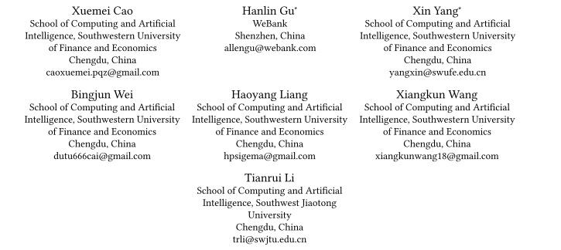



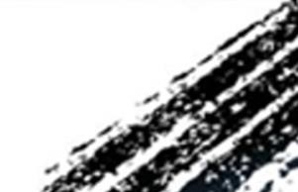

ATAI
Advanced Techniqueof Artificial Intelligence
ATAI
ChongqingUniversity _{AdvancedTechniqueof}
of Technology Artificial Intelligence
Chongqing University of
Technology
Chongqing University ^{ATAI}
_{of Technology} Advanced Techniqueof
Artificial Intelligence
Chongqing University of Technology
Chongqing University of Technology
ErrorEraser: Unlearning Data Bias for Improved
Continual Learning
Code: thttps://github.com/diadai/ErrorEraser
—— KDD_2025
Reported by HongLiang Nie
1

Slide 2

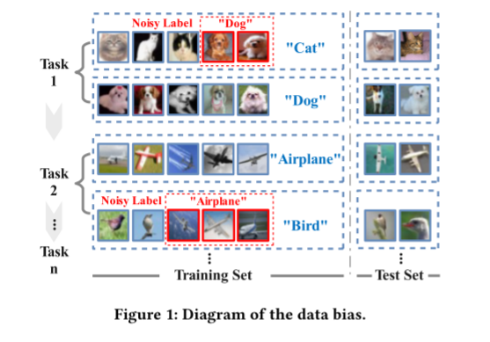
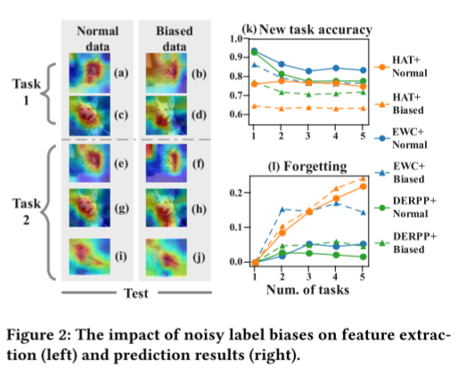
ATAI
AdvancedTechniqueof
Artificial Intelligence
ATAI
ChongqingUniversity _{AdvancedTechniqueof}
of Technology Artificial Intelligence
ChongqingUniversity of Technology
Motivation
1. Continual Learning (CL) primarily aims to retain knowledge to prevent catastrophic forgetting and transfer knowledge to facilitate learning new tasks
2. existing CL methods ignoring biases in real-world data, leading the model to learn spurious correlations that transfer and amplify across tasks.
3. From feature extraction and prediction results, we find that data biases simultaneously reduce CL’s ability to retain and transfer knowledge.

Slide 3

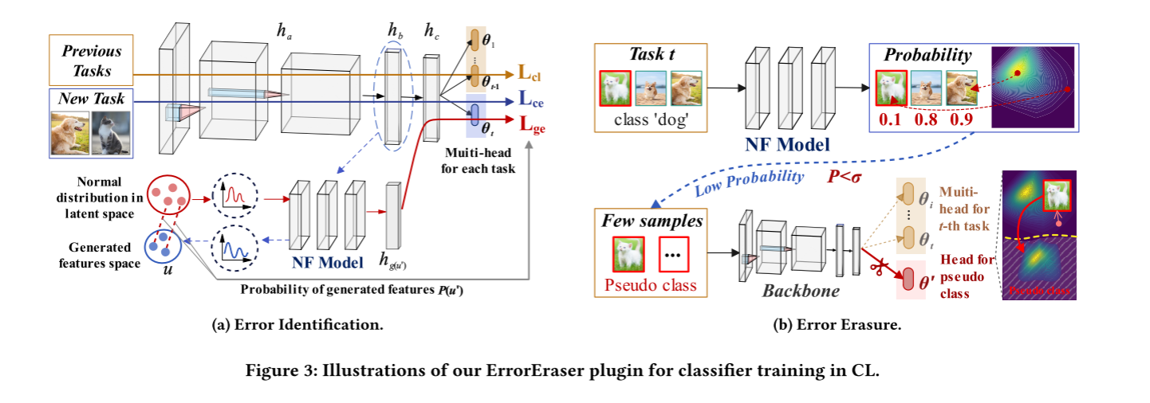
ChongqingUniversity of Technology
ATAI
AdvancedTechniqueof
Artificial Intelligence
ATAI
ChongqingUniversity _{AdvancedTechniqueof}
of Technology Artificial Intelligence
Overview

Slide 4
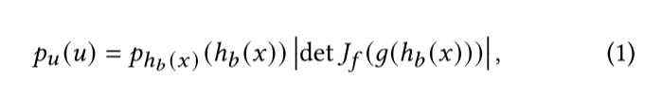
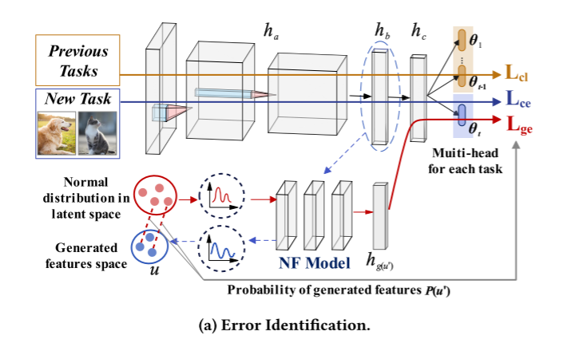
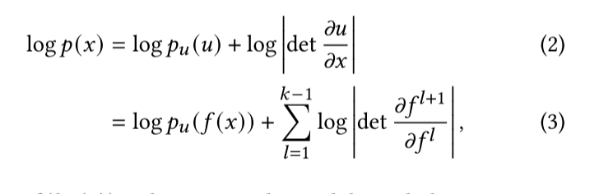
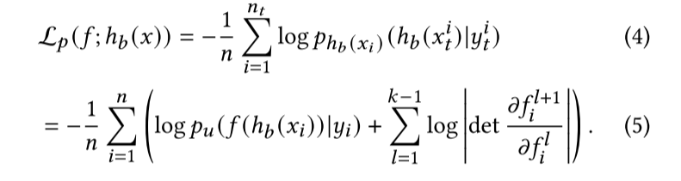
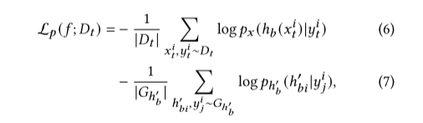



ChongqingUniversity of Technology
ATAI
AdvancedTechniqueof
Artificial Intelligence
ATAI
ChongqingUniversity _{AdvancedTechniqueof}
of Technology Artificial Intelligence
Method

Slide 5
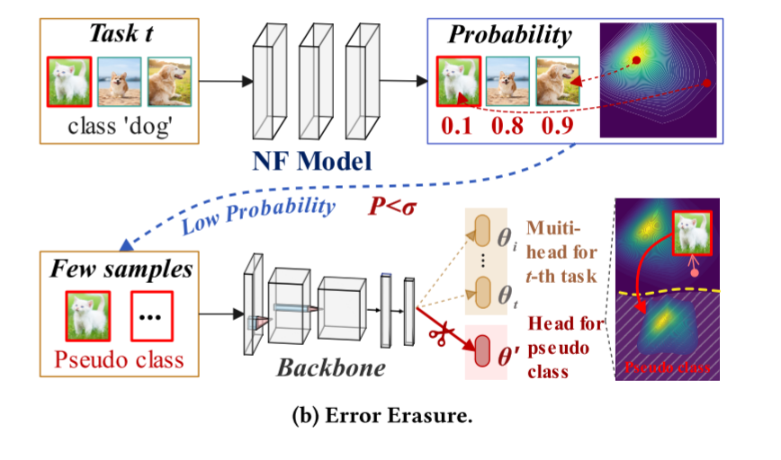


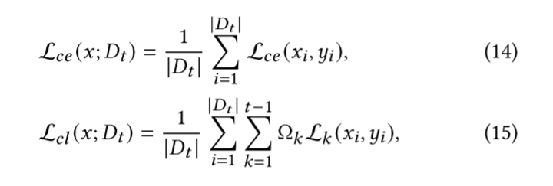
ChongqingUniversity of Technology
ATAI
AdvancedTechniqueof
Artificial Intelligence
ATAI
ChongqingUniversity _{AdvancedTechniqueof}
of Technology Artificial Intelligence
Method

Slide 6

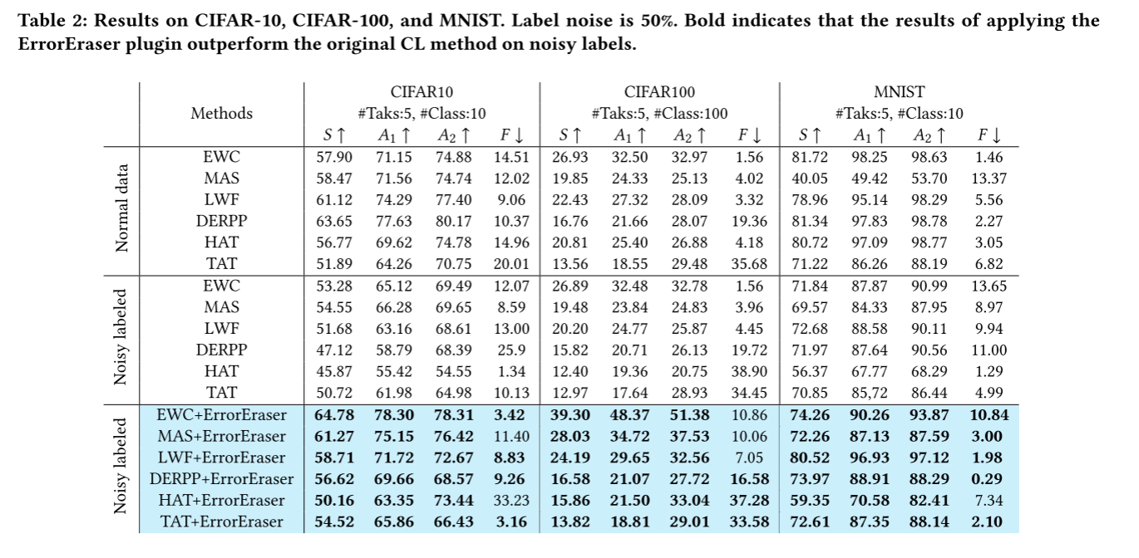
ATAI
AdvancedTechniqueof
Artificial Intelligence
ATAI
ChongqingUniversity _{AdvancedTechniqueof}
of Technology Artificial Intelligence
ChongqingUniversity of Technology
Experiments

Slide 7
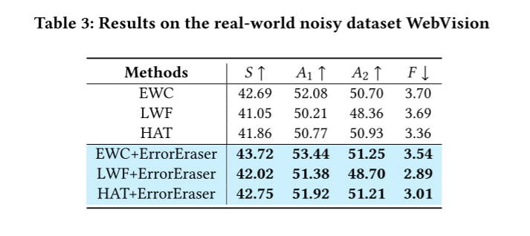
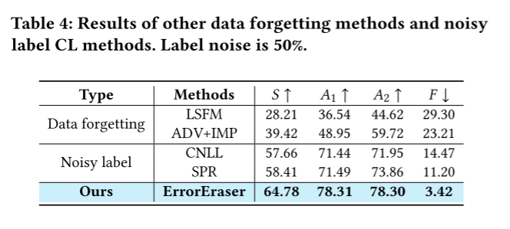
ATAI
AdvancedTechniqueof
Artificial Intelligence
ATAI
ChongqingUniversity _{AdvancedTechniqueof}
of Technology Artificial Intelligence
ChongqingUniversity of Technology
Experiments

Slide 8
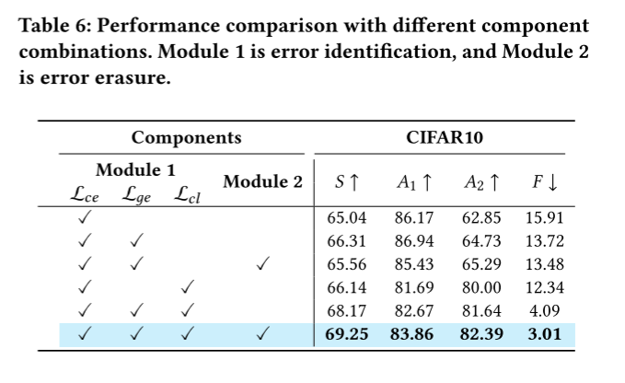
ATAI
AdvancedTechniqueof
Artificial Intelligence
ATAI
ChongqingUniversity _{AdvancedTechniqueof}
of Technology Artificial Intelligence
ChongqingUniversity of Technology
Experiments

Slide 9
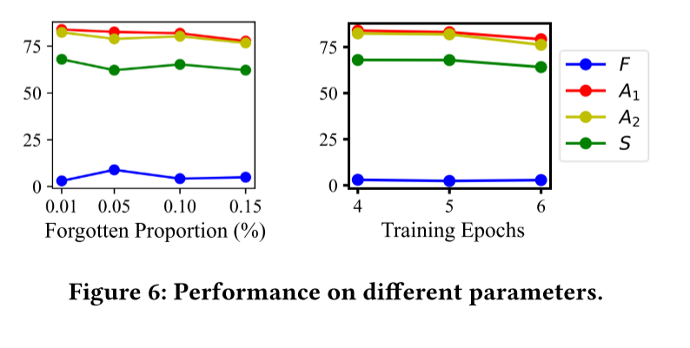
ATAI
AdvancedTechniqueof
Artificial Intelligence
ATAI
ChongqingUniversity _{AdvancedTechniqueof}
of Technology Artificial Intelligence
ChongqingUniversity of Technology
Experiments

Slide 10
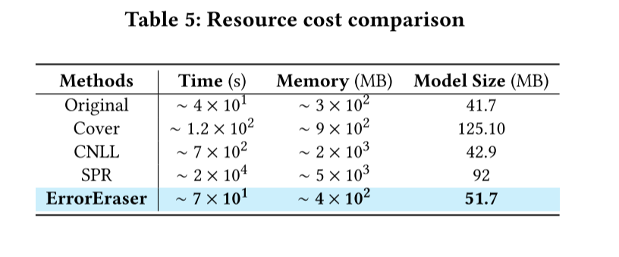
ATAI
AdvancedTechniqueof
Artificial Intelligence
ATAI
ChongqingUniversity _{AdvancedTechniqueof}
of Technology Artificial Intelligence
ChongqingUniversity of Technology
Experiments

Slide 11
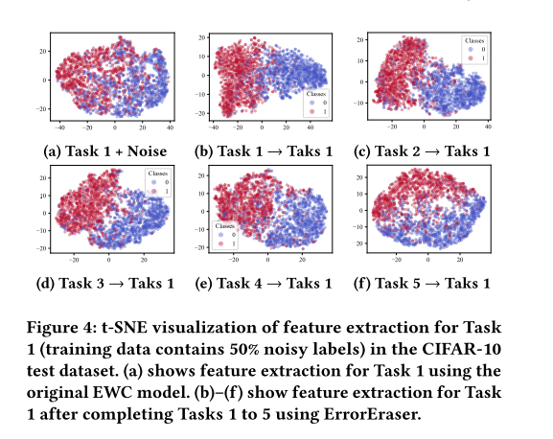
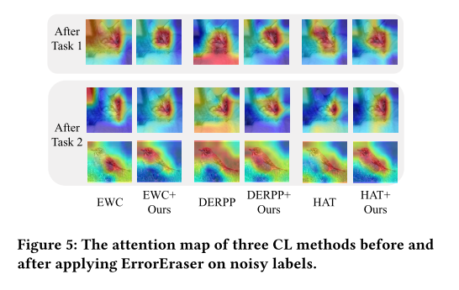
ATAI
AdvancedTechniqueof
Artificial Intelligence
ATAI
ChongqingUniversity _{AdvancedTechniqueof}
of Technology Artificial Intelligence
ChongqingUniversity of Technology
Experiments

Slide 12


ChongqingUniversity of Technology
ATAI
AdvancedTechniqueof
Artificial Intelligence
ATAI
ChongqingUniversity _{AdvancedTechniqueof}
of Technology Artificial Intelligence
Thanks!

